Slide 1
Normalized model vs dimensional model

Slide 2
Relational modeling (Codd, ‘69)
relation = a set of tuples that have the same attributes
primary key (a column or group of columns to uniquely identify each row)
foreign key (a column or group of columns in one table that points to the primary key of another table)
index = a way of providing quicker access to data (B+ trees, R-trees, bitmaps)

Slide 3
Relational modeling
Relational operators
  Union
  Intersection
  Difference
  Cartesian product
  Selection
  Projection
  Join

Slide 4
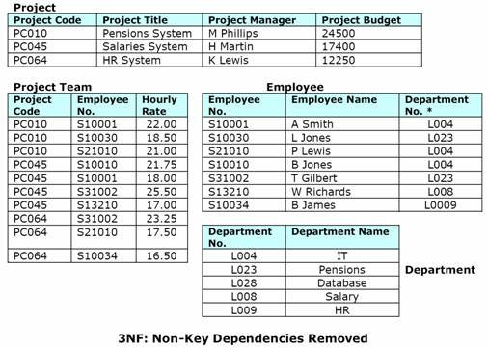
Relational modeling
Normalization
  3NF
  "[Every] non-key [attribute] must provide a fact about the key, the whole key, and nothing but the key" …
”so help me Codd”

Slide 5
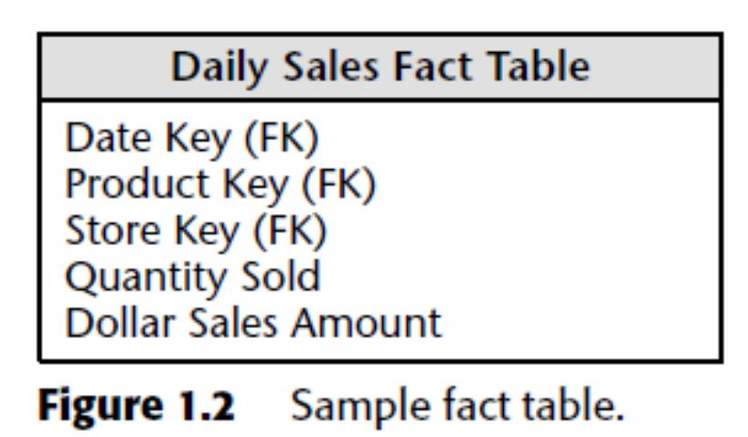
Dimensional modeling (Kimball)
Fact tables
  the primary table in a dimensional model where the numerical performance measurements of the business are stored
  The most useful facts
  are numeric and additive

Slide 6
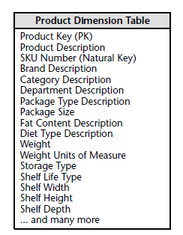
Dimensional modeling
Dimension tables
  contain the textual descriptors of the business
  entry points into the fact table

Slide 7
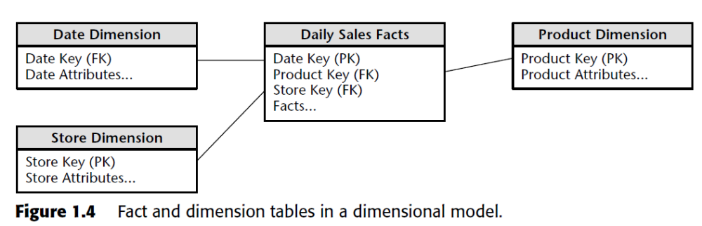
Dimensional modeling
Bringing together facts and dimensions
STAR SCHEMA

Slide 8
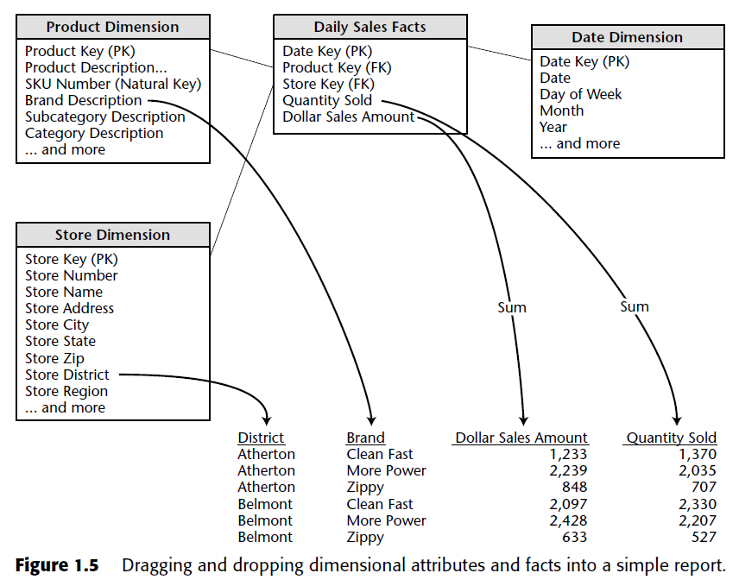

Slide 9
Four-Step Dimensional
Design Process
1. Select the business process to model.
2. Declare the grain of the business process.
3. Choose the dimensions that apply to each fact table row.
“How do business people describe the data that results from the business process?”
4. Identify the numeric facts that will populate each fact table row.
“What are we measuring?”

Slide 10
Retail Case Study
100 grocery stores spread over a five-state area
departments: including grocery, frozen foods, dairy, meat, produce, bakery, floral, and health/beauty aids
roughly 60,000 individual products
data collection:
  at the cash registers as customers purchase products
  at the back door, where vendors make deliveries

Slide 11
Retail Case Study
management is concerned with the logistics of:
  ordering
  stocking
  selling
while maximizing profit
pricing
promotions

Slide 12
Step 1. Select the Business Process
The first dimensional model built should be the one with the most impact—it should answer the most pressing business questions and be readily accessible for data extraction.
In our case study, management wants to better understand customer purchases as captured by the POS system

Slide 13
Step 2. Declare the Grain
Preferably you should develop dimensional models for the most atomic information captured by a business process.
In our case study, the most granular data is an individual line item on a POS transaction

Slide 14
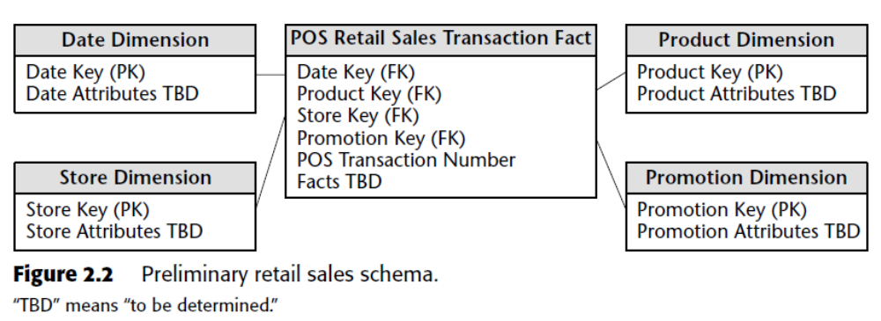
Step 3. Choose the Dimensions
A careful grain statement determines the primary dimensionality of the fact table.

Slide 15
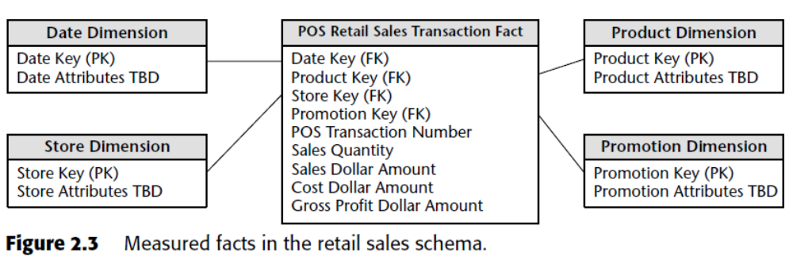
Step 4. Identify the Facts

Slide 16
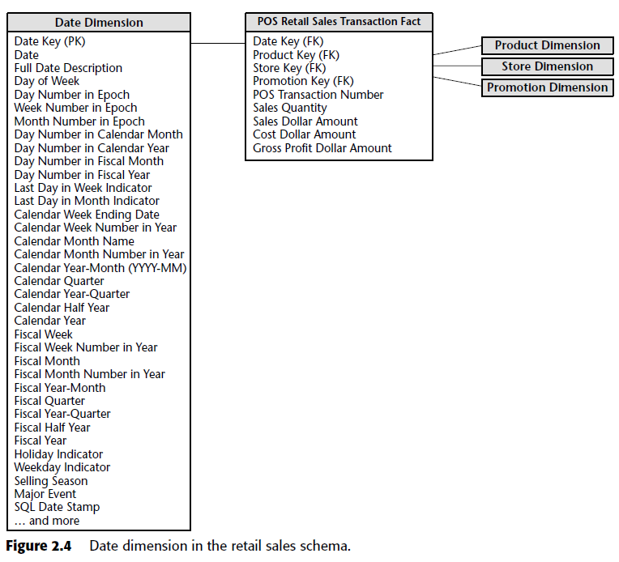
Data warehouses always need an explicit date dimension table. There are many date attributes not supported by the SQL date function, including fiscal periods, seasons, holidays, and weekends. Rather than attempting to determine these nonstandard calendar calculations in a query, we should look them up in a date dimension table.

Slide 17
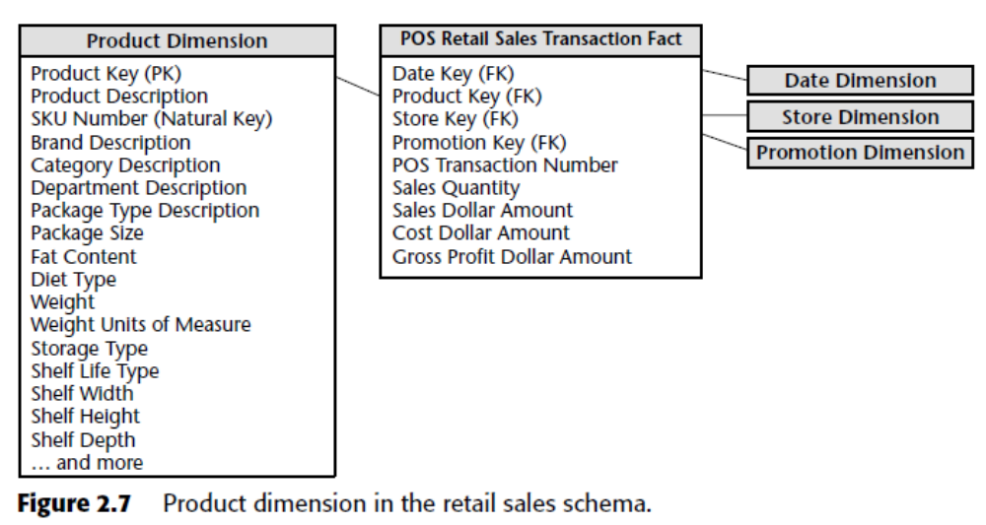

Slide 18
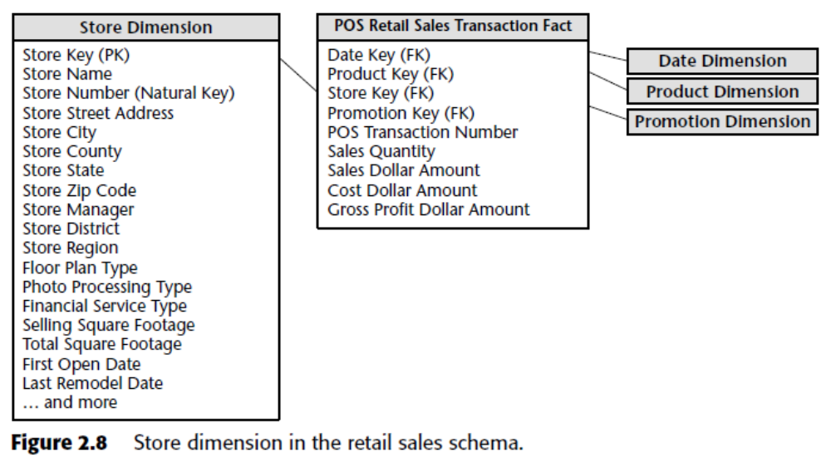

Slide 19
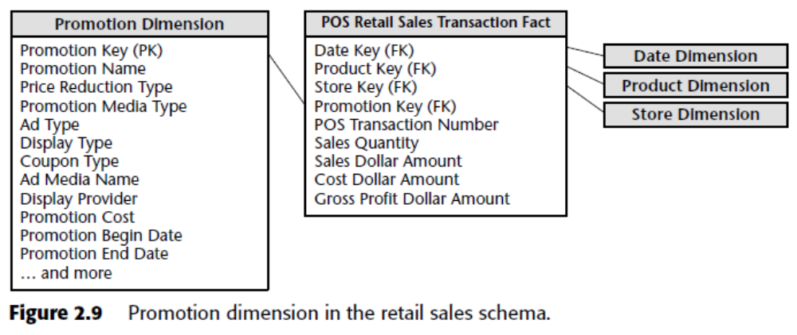

Slide 20
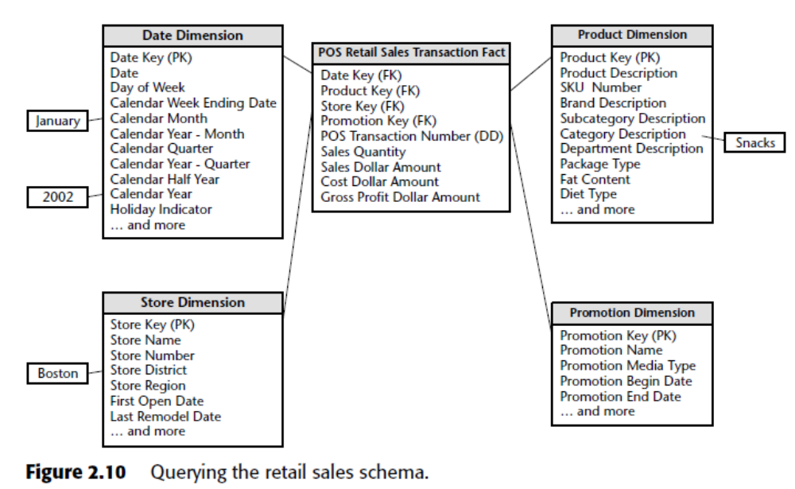

Slide 21
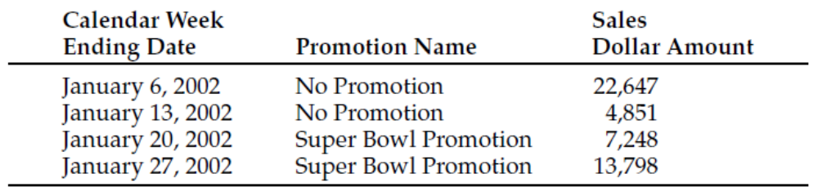
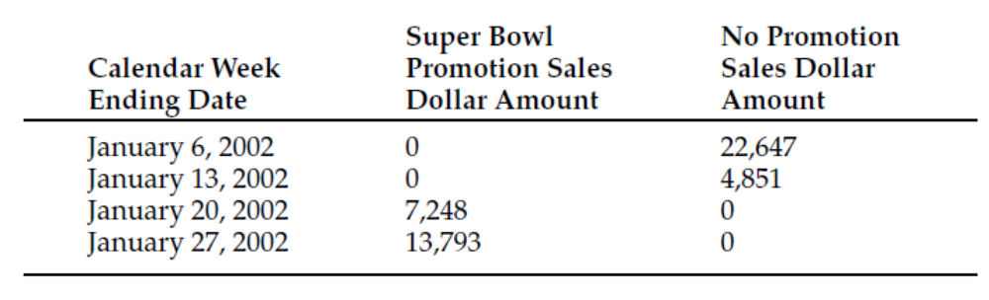
Retail Schema in Action

Slide 22
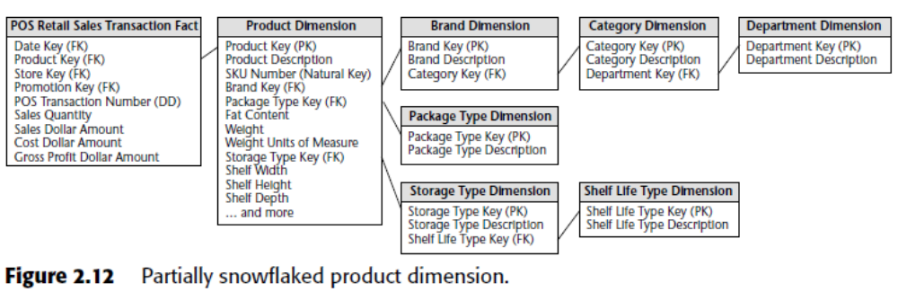
Dimension Normalization -
Snowflaking
SNOWFLAKE SCHEMA

Slide 23
Case study – Babes-Bolyai University
3-5 persons teams
create a dimensional model of data available at UBB
consider one business process

